Slide 1
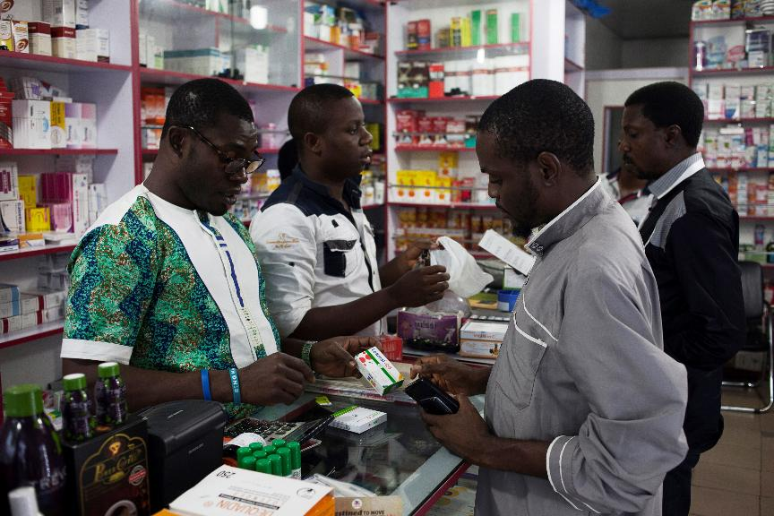

[COUNTRY, YEAR]
Module 1:
Study and training intro

Slide 2
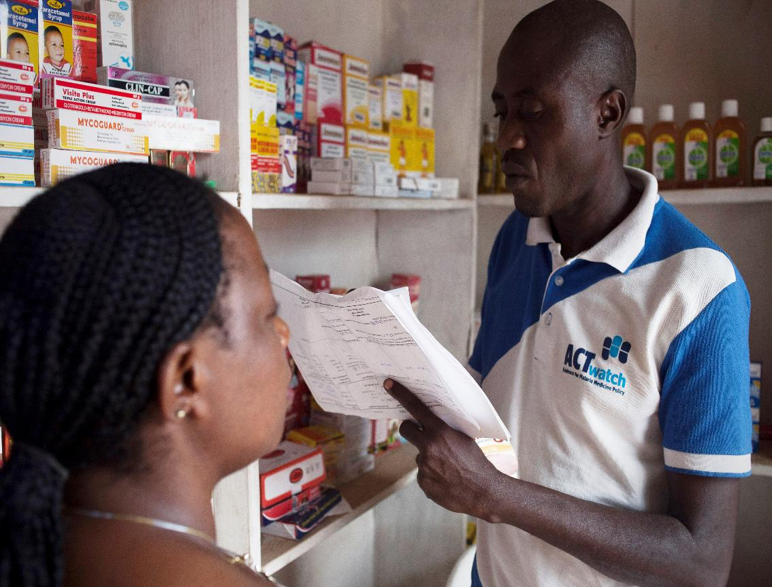
Agenda
1.1 Presentation of the training agenda
1.2 Ground Rules and Expectations
1.3 Training objectives
1.4 Malaria context
1.5 ACTwatch Lite overview

Slide 3
Registration and introductions
Sign in using the registration sheet provided by your training facilitators
Introductions-- Can everyone share:
What is your name?
Where are you from?
Background/institution
Any experience with ACTwatch?
Your favorite food?

Slide 4
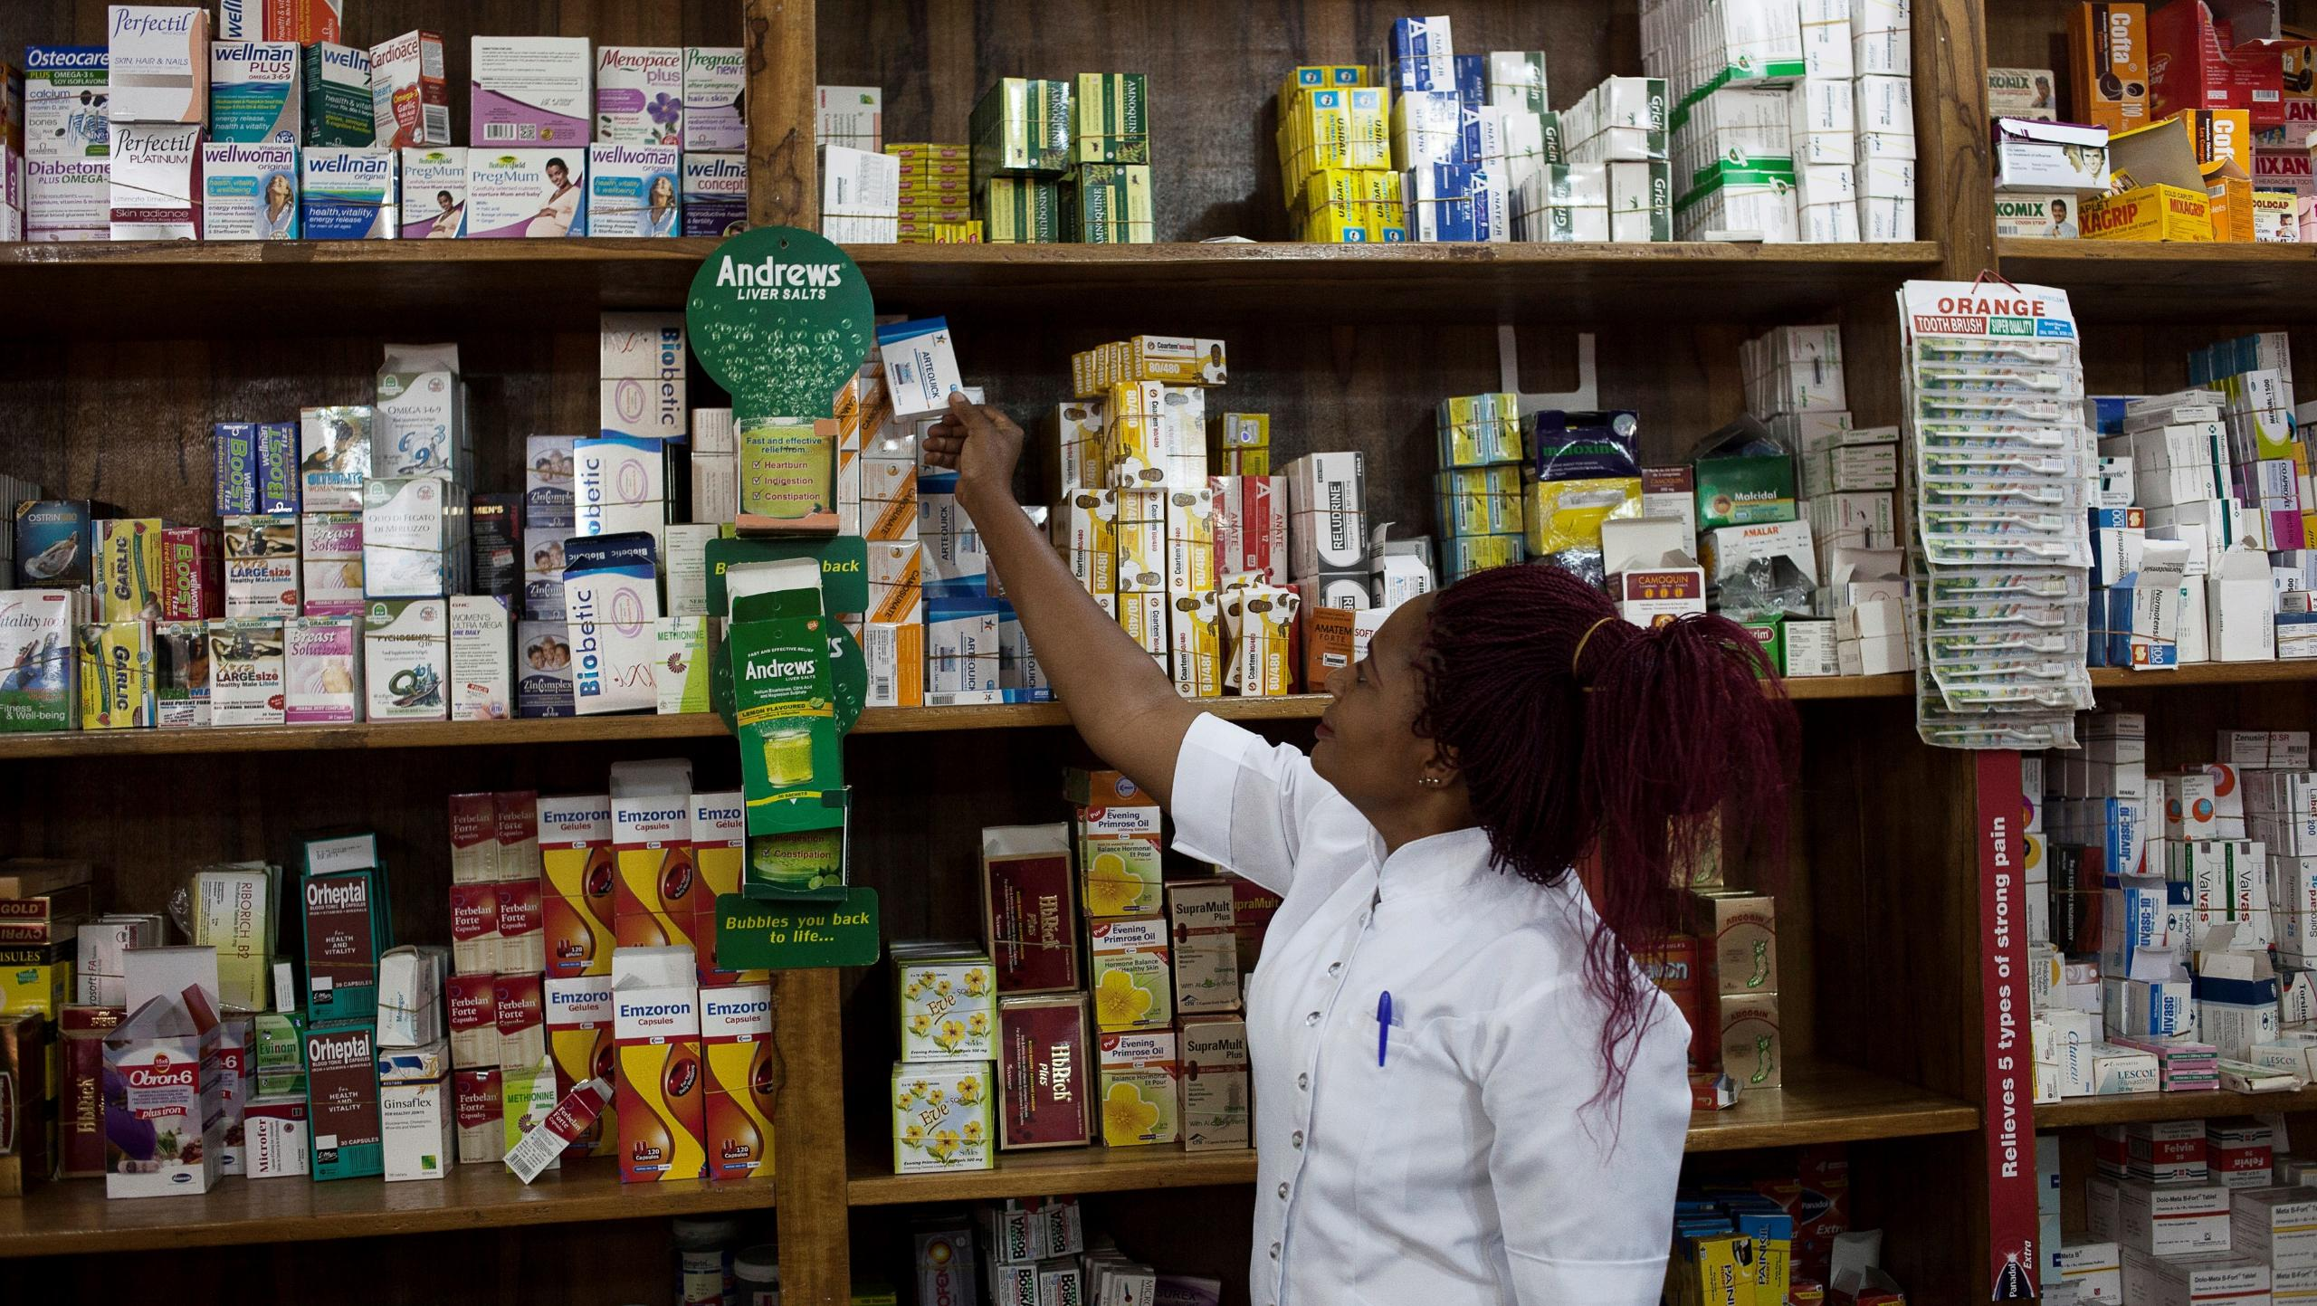
1.1 Presentation of the training agenda

Slide 5
INSERT SCREENSHOT OF AGENDA for YOUR TRAINING HERE. THIS SHOULD ALSO BE PRINTED AND SHARED WITH PARTICIPANTS.

Slide 6

1.2 Ground Rules and Expectations

Slide 7
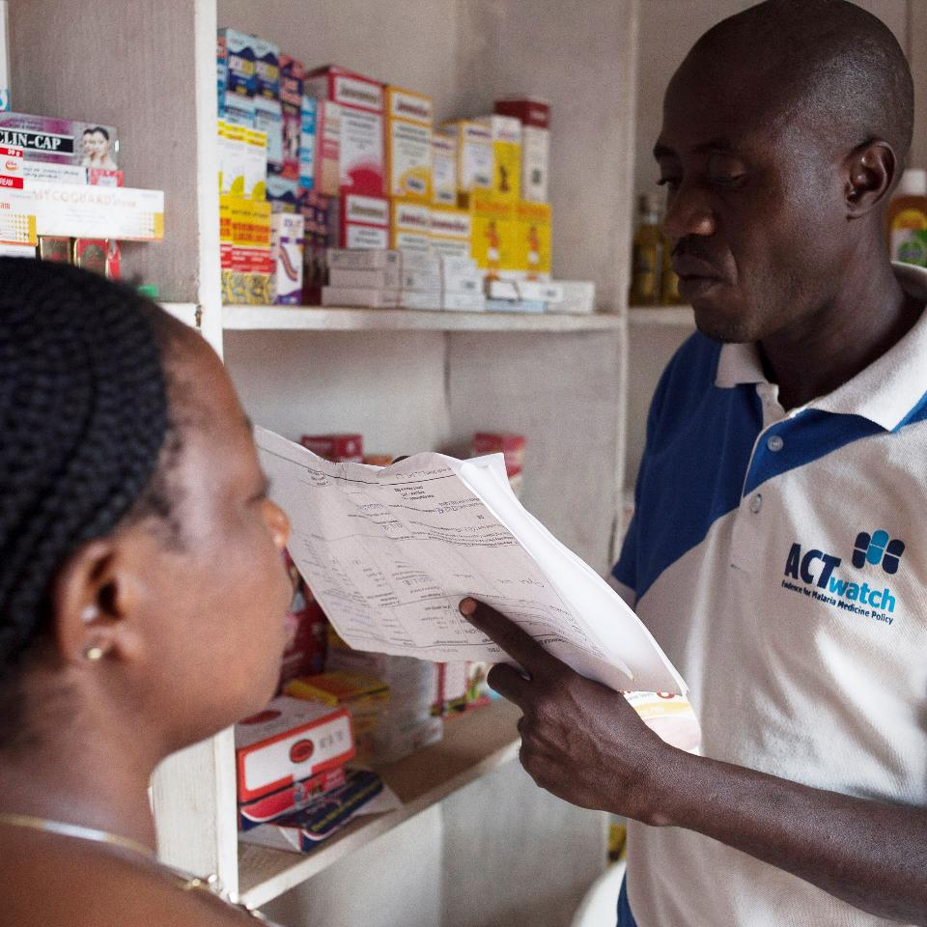
What rules and expectations should we have for this training?

Slide 8

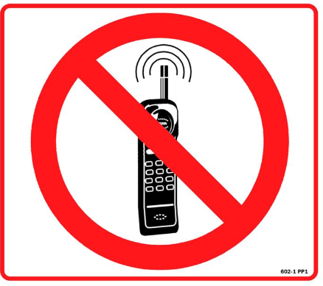
Rules:
Do not be late to training, after breaks, or lunch. Please do not leave the training before the end of the day. Arriving late without a valid reason will result in disqualification.
Switch off your phones or put them on silent mode. No laptops or other electronic devices should be used outside of break times.
All tests and exercises are compulsory. Cheating will result in disqualification.

Slide 9

Expectations:
Ask questions.
Help each other.
Use inclusive language.
Respect the comments and opinions of others.
Share your suggestions or comments with the trainers to improve the session.
If you feel the trainer is going too fast, you can ask him to slow down a little.

Slide 10

End of session 1.2
Thank you for your attention!
Any questions?

Slide 11

General knowledge pre-test
Do the General Knowledge Pre-test alone – no discussion.
Score each other’s work and report back.
Notes:
FACILITATOR NOTES:
We use TRUE/FALSE to evaluate the pre- and post-test. We use the same exercise for both pre- and post-test. Answers aren’t provided after the pre-test, instead, each module offers clear explanations of the questions. Answers are only provided following the post-test.

Slide 12
1.3 Training objectives

Slide 13
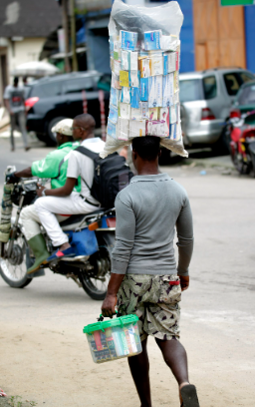
Training Objectives:
Be able to identify outlet types to include in a full census of the private sector in study areas.
Be able to conduct a successful provider interview using the SurveyCTO tool.
Be able to identify malaria commodities (RDTs and antimalarials) and capture information from their packaging for the product audits.
Understand roles, responsibilities, procedure & workflow in the field.

Slide 14
End of session 1.4
Thank you for your attention!
Any questions?

Slide 15
1.4 Malaria context

Slide 16
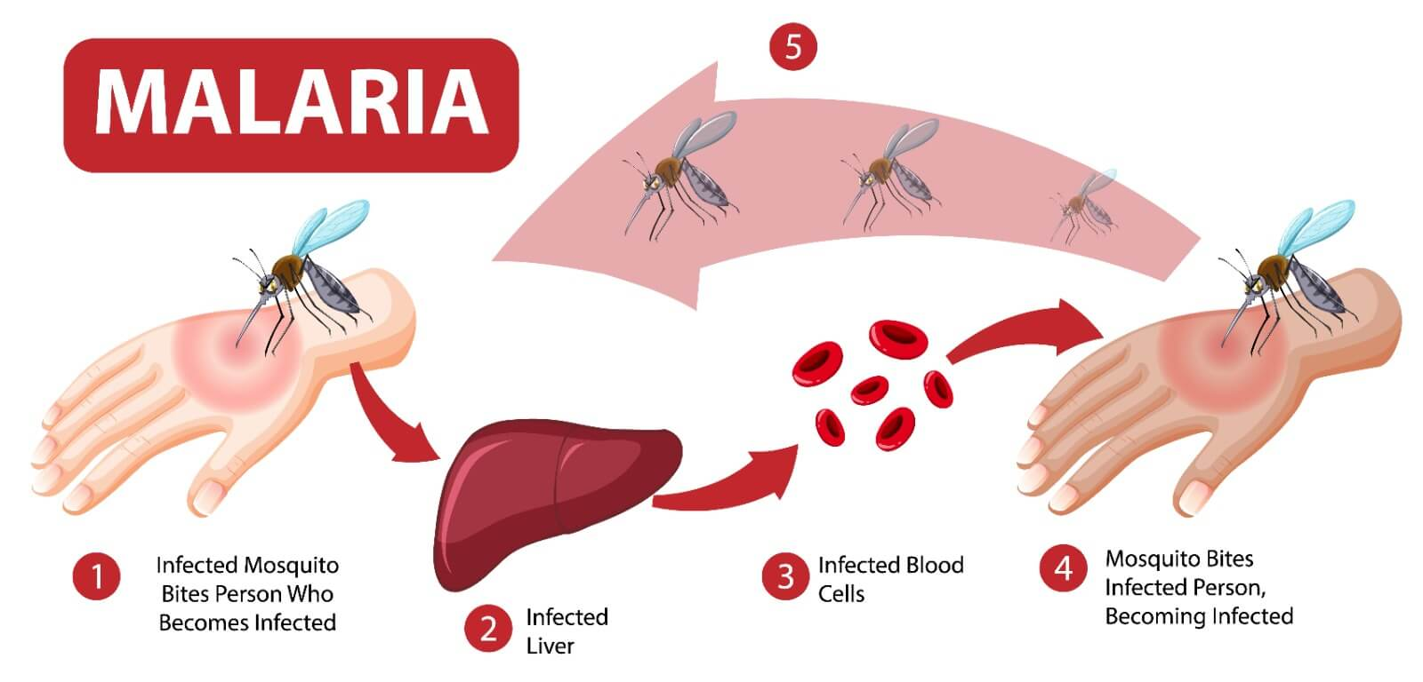
WhAT IS MALARIA?
Definition: Malaria is a potentially fatal febrile disease caused by Plasmodium parasites, transmitted by infected female Anopheles mosquitoes.
Symptoms: Includes fever, chills, headache, nausea, and muscle pain; severe cases can lead to organ failure.
Types of Plasmodium: Five species infect humans; Plasmodium falciparum and Plasmodium vivax are the most common.

Slide 17
Uncomplicated malaria and severe malaria
Uncomplicated Malaria | Severe Malaria
Can be caused by all Plasmodium species. Symptoms generally occur 7-10 days after the initial mosquito bite. Symptoms are non-specific and can include fever, moderate to severe shaking chills, profuse sweating, headache, nausea, vomiting, diarrhoea and anaemia, with no clinical or laboratory findings of severe organ dysfunction. | Severe malaria is usually caused by infection with Plasmodium falciparum. Complications include severe anaemia and end-organ damage, including coma (cerebral malaria), pulmonary (lung) complications (for example, oedema and hyperpnoeic syndrome) and hypoglycaemia or acute kidney injury. Severe malaria is often associated with hyperparasitaemia (very high levels of malaria parasites in the blood) and is associated with increased risk of death.

Slide 18
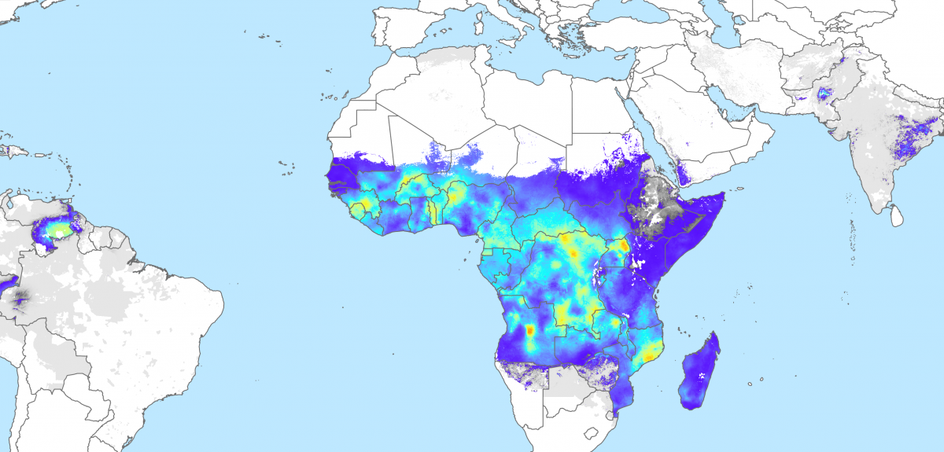
Epidemiological situation - Worldwide
Key facts
Globally in 2022, there were an estimated 249 million malaria cases and 608,000 malaria deaths in 85 countries.
The WHO African Region carries a disproportionately high share of the global malaria burden.
In 2022, the Region was home to 94% of malaria cases (233 million) and 95% (580,000) of malaria deaths.
Children under 5 accounted for about 80% of all malaria deaths in the Region.
Note: update this slide with the most recent World Malaria Report or other relevant data source
Source: Malaria Atlas Project
Source: https://www.who.int/news-room/fact-sheets/detail/malaria
29 May 2024

Slide 19
Epidemiological situation – [COUNTRY]
To be updated with current country data. A graphic with geographical impact is suggested to be added here as a visual
Malaria is a major public health concern in [country]
~XX cases and XX deaths due to the disease in [year].
[Country] accounts for nearly XX% of the global malaria burden.

Slide 20
MALARIA Prevention
There are several strategies and interventions to prevent infection and reduce transmission of malaria in at-risk communities:
Vector control
Insecticide-treated mosquito nets
Intra-domiciliary spraying (IDS)
Larval source management
Chemoprophylaxis (travelers)
Chemoprevention (IPTp, PMC, SMC, PDMC, MDA)
Vaccination (RTS,S/AS01; R21)
Combining strategies

Slide 21
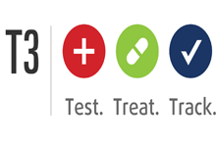
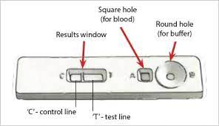
Malaria diagnosis
Policy: Since 2010, the WHO has adopted a test, treat, and track policy, recommending all suspected cases of malaria (fevers) are tested.
Test types: The most common tools are Microscopy and malaria Rapid Diagnostic Tests (RDTs).
Importance of Prompt Diagnosis: Early and accurate diagnosis is crucial for effective treatment and preventing severe complications.
Challenges: Limited access to diagnostic tools in rural and resource-poor areas, and potential for false negatives in low-parasite-density infections.
RDTs:

Slide 22
MALARIA Treatment
Have you ever had malaria?
What treatment did you receive?
The first-line treatment for uncomplicated malaria is Artemisinin-based Combination Therapies (ACTs).
For severe cases* treatment may be artesunate/artemether injection, artesunate suppository†, quinine injection, followed by a full course of ACT.
The specific drug prescribed will vary depending on:
Type of malaria
Parasite resistance to a drug
Weight or age, pregnant or not
*Severe malaria occurs when infections are complicated by serious organ failures or abnormalities in the patient’s blood or metabolism.
† Use of the artesunate suppository is strictly for pre-referral management.

Slide 23
End of session 1.4
Thank you for your attention!
Any questions?

Slide 24
1.5 ACTwatch Lite overview

Slide 25
TRAINER NOTES
Objective:
Introduce participants to the ACTwatch Lite project, its purpose, methods, and how it supports malaria case management through private sector data.
Prompts & Answers:
What is ACTwatch Lite? ➔ A streamlined malaria market study focused on the private sector (formal & informal). ➔ It collects data on availability, price, sales, and supply chains for antimalarials and RDTs.
Why focus on the private sector? ➔ In many countries, a large proportion of people seek treatment from private outlets. ➔ There is often limited data from this sector for national programs to act on.
What type of outlets are included? ➔ Retail outlets (pharmacies, clinics, drug shops). ➔ Wholesalers and importers.
What is done at each outlet? ➔ Interview the provider and conduct a product audit of all antimalarials and RDTs in stock.

Slide 26
ACTwatch IS THE key source of data on the availability, price, and market share of malaria commodities IN THE PRIVATE SECTOR
ACTwatch malaria market studies have been conducted since 2007 and generate malaria treatment, diagnostic and provider data from formal and informal private sector outlets and their supply chains.
Findings have been used by national malaria programs, donors, and implementing partners to inform strategic planning, improve regulatory enforcement, target behavior change interventions, and guide subsidy and distribution policies to expand access to quality-assured malaria commodities.
[IF OTHER ACTWATCH OR SIMILAR MARKET STUDIES HAVE BEEN CONDUCTED PREVIOUSLY, ADD SUMMARY OF RESULTS HERE]

Slide 27
The ACTWATCH LITE PROJECT IS A Streamlined multi-country market study:
Tools have been updated to use electronic data collection and take advantage of a database of known malaria products to reduce data collection times.
Methods have been focused to private sector outlets.
As a result → data, methodology and tools are made rapidly available to National Malaria Programs & stakeholders for an up-to-date understanding of private sector malaria markets to inform strategic and programmatic decision-making for private sector case management.
Note to presenter: an editable map of the African continent is provided. The implementation country can be filled in with a different color.

Slide 28
Why [COUNTRY]?
To be updated with current country data.
Suggestion: Add country flag to the right of the country name.
[Country]’s private sector (formal and informal) is a major source of care (X% of care seeking for fever in 20XX *note this should be available from the most recent DHS or MIS)
Quality of treatment practices, product availability, and provider capacity in the informal sector are not known.
A key barrier to progress is a lack of robust, contemporary data on private sector malaria markets that can be used by national decision-makers and their global partners to support appropriate intervention design.
[Insert additional reasons for why ACTwatch lite is being implemented in your country.]
Therefore, monitoring the private sector, including gathering high quality and actionable data on outlet practices and AM / RDT availability, price, etc. is essential in meeting objectives of [Country’s] National Malaria Strategic Plan (Insert Year - XXXX)

Slide 29




ACTwatch Lite : Study Overview
1
Interviews with importers of antimalarials and RDTs at the national level.
Retail-level outlet survey among private sector outlets providing antimalarials and/or RDTs and diagnostic testing services to the general population.
Wholesale-level outlet survey among terminal wholesalers providing antimalarials and RDTs to outlets targeted at the retail-level.
2
Commune
Ross et frères
Laveran Ets
Laveran Ets
Laveran Ets
Ross et frères
Marché
Ross et frères
Laveran Ets
3
Commune

Slide 30
DESIGN, METHODS, AND SCOPE
Design and methods:
Cross-sectional survey (subnational quantitative estimates)
Zones/states/regions have been randomly sampled
Within sampled areas, we will do a full census of all non-government outlets with the potential to stock antimalarials/testing
Audit of all antimalarials and RDTs in stock
Business characteristics and practices, data reporting/surveillance, digital engagement, suppliers and supply practices
Geographic scope
XX states/regions, selected based on:
Geopolitical zone range
Presence and size of malaria commodity supply chain actors
Malaria burden
Additional reasons
Outlets to included:
Private clinics, hospitals, community pharmacies and other retailers or informal outlets
Terminal wholesalers supplying retailers
Registered pharmaceutical importers/wholesalers
To be updated with data from the current project country
(mainly texts highlighted in yellow).
Add map of selected zones or regions here.

Slide 31
Fieldwork, Data analysis and Use
Field teams
Intensive 10-day training and piloting for data collectors.
Fieldwork overseen by field team supervisors, [implementing organization] teams and stakeholders.
Data collection
Implemented with Open Data Kit (ODK)-programmed tools in SurveyCTO, including pre-loaded commodity details and comprehensive internal logic checks.
Data analysis and use
Remote data QC.
Phase one quantitative analysis aiming for completion in the weeks following fieldwork.
Results workshop held with national partners once phase one results are available.
Phase two quantitative and qualitative analysis for narrative reporting complete in weeks following workshop.

Slide 32
Key Indicators
E.g.:
Quality-assured ACTs (WHO prequalified)
First-line ACTs
Non-QA ACTs
Non-artemisinin therapies
Artemisinin monotherapies
Retail and Wholesale
Availability of antimalarials by group and any specific generic/brand on the market
Availability of malaria blood testing, including microcopy (self-reported) and RDTs
Retail price and mark-ups of antimalarials and malaria blood testing services
Antimalarial market share by antimalarial groups and brand
Business characteristics and practices
Provider engagement in national malaria surveillance and reporting
Provider digital capacity and attitudes toward potential digital services
Common wholesale sources and resupply practices
Wholesale (and importers)
Customer characteristics
Distribution footprint in terms of geographic reach and number/range of customers
Distribution practices

Slide 33
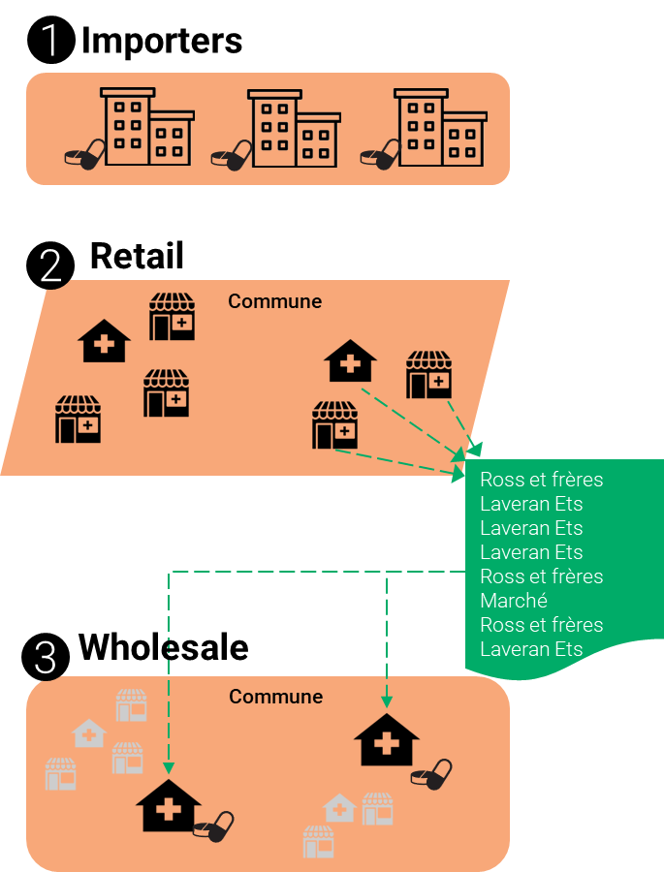
DATA COLLECTION TOOLS
To capture information at each level of the supply chain, tools have been developed for semi-structured interviews with importers and quantitative questionnaires for survey of wholesalers and retailers

Slide 34
DATA COLLECTION TOOLS
Interviews with importers done by [implementing organization]
Products stocked (antimalarials and TDRs)
Pricing
Distribution network and practices
Competition
Information sources
Sales revenue
Regulations

Slide 35
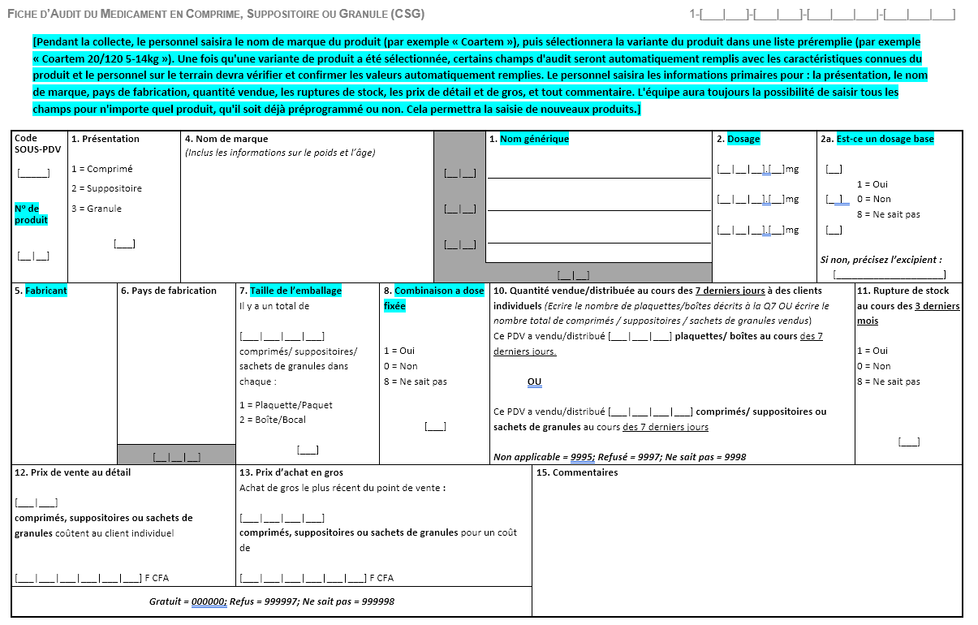


DATA COLLECTION TOOLS
Market survey of retail outlets and wholesalers done by [Insert Research Agency or Implementing Organization here]
Product audits
Product supply
Point-of-sale features
Participation in the monitoring system and supervisory visits
Experience and attitudes towards digital services
Registration status

Slide 36
ACTwatch Lite: outlet questionnaire flow
Census information
Outlet characteristics
Eligibility questions
Operational practices
Provider characteristics
Malaria knowledge
Digital preparedness/ practices
AM suppliers
Product supplier information
RDT suppliers
Product audits
Antimalarials
Interview status
RDTs

Slide 37
End of session 1.5
Thank you for your attention!
Any questions?

